Slide 1
Object Oriented Programming
Prof. Varsha Dange

Slide 2
Section 2 Lecture – 22
Prof. Varsha Dange

Slide 3
Ways of handling exception
Keyword | Description
try | The "try" keyword is used to specify a block where we should place an exception code. It means we can't use try block alone. The try block must be followed by either catch or finally.
catch | The "catch" block is used to handle the exception. It must be preceded by try block which means we can't use catch block alone. It can be followed by finally block later.
finally | The "finally" block is used to execute the necessary code of the program. It is executed whether an exception is handled or not.
throw | The "throw" keyword is used to throw an exception explicitly.
throws | The "throws" keyword is used to declare exceptions. It specifies that there may occur an exception in the method. It delegates the exception to caller method. It is always used with method signature.

Slide 4
Try And Catch Blocks
Try block is used to enclose the code that might throw an exception.
It must be used within the method.
If an exception occurs at the particular statement in the try block, the rest of the block code will not execute.
not to keep the code in try block that will not throw an exception.
Try block must be followed by either catch or finally or both .
For each try block there can be one or more catch blocks, but only one finally block.

Slide 5
Try And Catch Blocks
catch block is used to handle the Exception by declaring the type of exception within the parameter.
catch block must be used after the try block only.
Finally block is optional.
finally block is a block used to execute important code such as closing the connection, etc.
Java finally block is always executed whether an exception is handled or not.
So , it contains all the necessary statements that need to be printed regardless of the exception occurs or not.

Slide 6
Try And Catch Blocks
try
{ // the code you think can raise an exception }
catch(Exception_name reference_object) { // exception handler for ExceptionType1 }
finally
{ //block of code to be executed after try block ends ; }
Example without Exception handling
Example with Exception handling

Slide 7
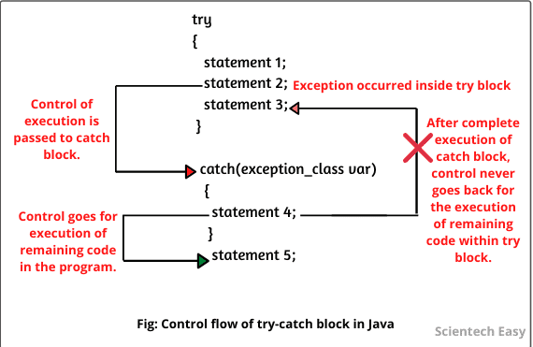
Try And Catch Blocks

Slide 8
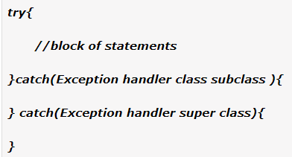
Multi-catch block
A try block can be followed by one or more catch blocks.
At a time only one exception occurs and at a time only one catch block is executed.
All catch blocks must be ordered from most specific to most general, i.e. catch for ArithmeticException must come before catch for Exception(i.e.super class)
Example Multi-Catch

Slide 9
finally block
finally block is a block used to execute important code such as closing the connection, freeing up resources, cleaning up code, close iostream etc.
Java finally block is always executed whether an exception is handled or not.
A java finally block is used to prevent resource leak.
it contains all the necessary statements that need to be printed regardless of the exception occurs or not.
The finally block follows the try-catch block.
Example1 Example2

Slide 10
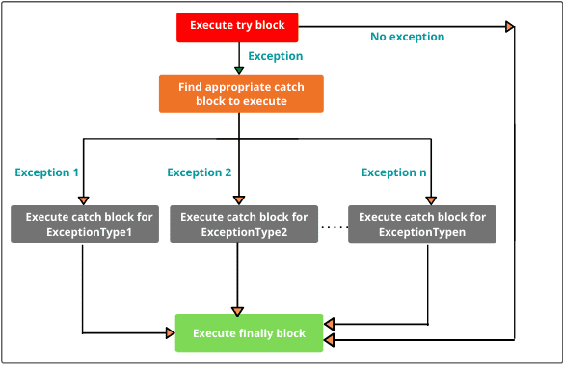
finally block

Slide 11
Throw keyword
The Java throw keyword is used to explicitly or manually throw an exception within a method or block of code.
We can define our own set of conditions or rules and throw an exception explicitly using throw keyword.
For example, we can throw ArithmeticException when we divide number by 5, or any other numbers,
what we need to do is just set the condition and throw any exception using throw keyword.
Throw keyword can also be used for throwing custom exceptions

Slide 12
Throw keyword
When an exception occurs in the try block, throw keyword transfers the control of execution to the caller by throwing an object of exception.
Syntax of throw keyword:
throw new exception_class("error message");
For example:
throw new ArithmeticException("dividing a number by 5 is not allowed in this program");
Example

Slide 13
Throws keyword
throws is a keyword in Java which is used in the signature of method
Throws indicate that method might throw one of the listed type exceptions.
Its not handling the exception ,its used only for delegation or propagation of exception purpose.
The caller to these methods has to handle the exception using a try-catch block.
More than one type of exception can be declared with method signature, they should be comma separated.

Slide 14
Throws keyword
Unchecked exceptions are automatically propagated but for checked can use throws
By the help of throws keyword we can provide information to the caller of the method about the exception.
throws keyword does not prevent abnormal termination of program.
Example

Slide 15
Difference between throw and throws
throw | throws
throw keyword is used to throw an exception explicitly. | throws keyword is used to declare one or more exceptions, separated by commas.
Only single exception is thrown by using throw. | Multiple exceptions can be thrown by using throws.
throw keyword is used within the method. | throws keyword is used with the method signature.
Syntax wise throw keyword is followed by the instance variable. | Syntax wise throws keyword is followed by exception class names.
Checked exception cannot be propagated using throw only.Unchecked exception can be propagated using throw. | For the propagation checked exception must use throws keyword followed by specific exception class name.

